Slide 1

A quick introduction to
and RStudio
To be used in courses that require such introduction, including TAM’s courses
Ecologia Numérica and Modelação Ecológica
at
FCUL
(but also to support the self paced learning github repository hosted at https://github.com/TiagoAMarques/AnIntro2RTutorial)

Slide 2
Learning goals
Obtain a working knowledge about the R software and environment, to be able to implement BASIC DATA analysis
Integration of R and RStudio, an helpful R interface, via a short introduction to R and RStudio followed by a hands on assisted tutorial

Slide 3
The R environment
R is both a programming language and an environment for statistical computation
R is free open source software
Created in 1995 by Ross Ihaka and Robert Gentleman, Department of Statistics of the University of Auckland, Auckland, New Zealand (gets its name from another famous programming language for data analysis, S)
Project is run by the appropriately named “R Core Development Team”
Software and extensive resources available at
http://www.r-project.org
I am using version 4.3.1 (2023-06-16) (those guys are fast…this will probably be outdated!)

Slide 4
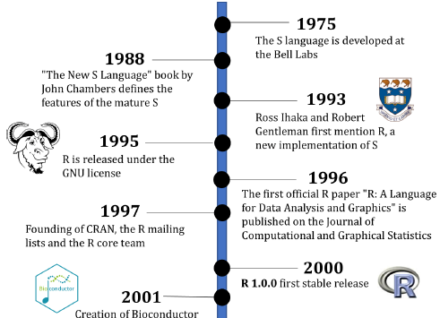
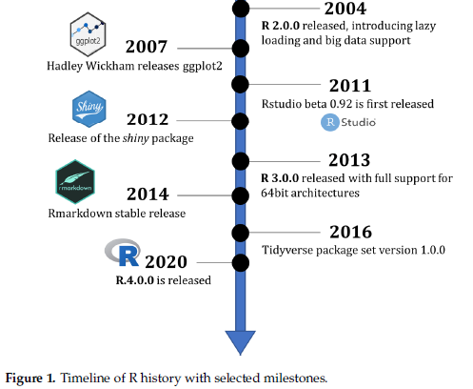
R: a selected timeline
In Giorgi et al. 2022 The R Language: An Engine for Bioinformatics and Data Science Life 12: 648
DOI: 10.3390/life12050648

Slide 5
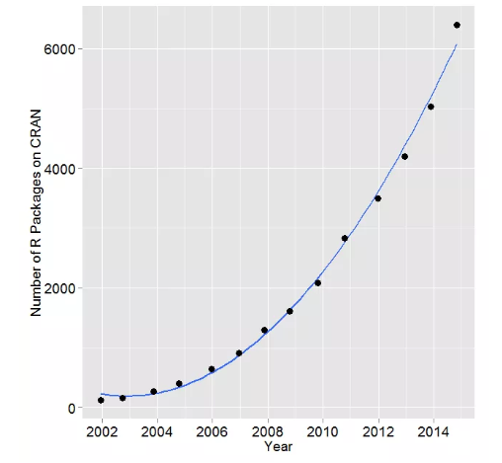
The R base + packages
R base installation comes with a number of libraries which provide access to a large number of commonly used features (e.g. linear models, survival analysis, basic statistical distributions, etc)
However, one of its strengths comes from the fact that many more packages are available online
Source: http://r4stats.com/articles/popularity/

Slide 6
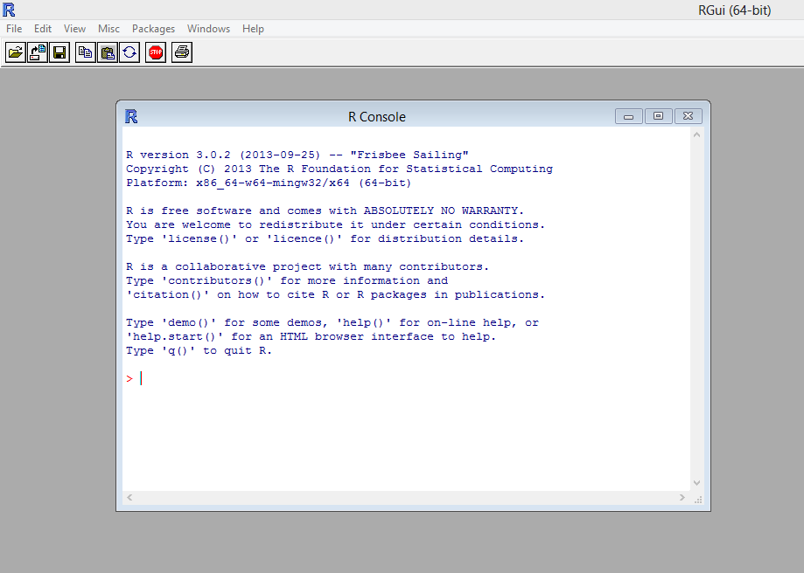
The R environment
R was traditionally accessed solely via the command line, making the learning curve rather steep for beginners
Here we focus on Rstudio, a program to interface with R, making many of the most common tasks simpler. Let’s open Rstudio shall we?

Slide 7
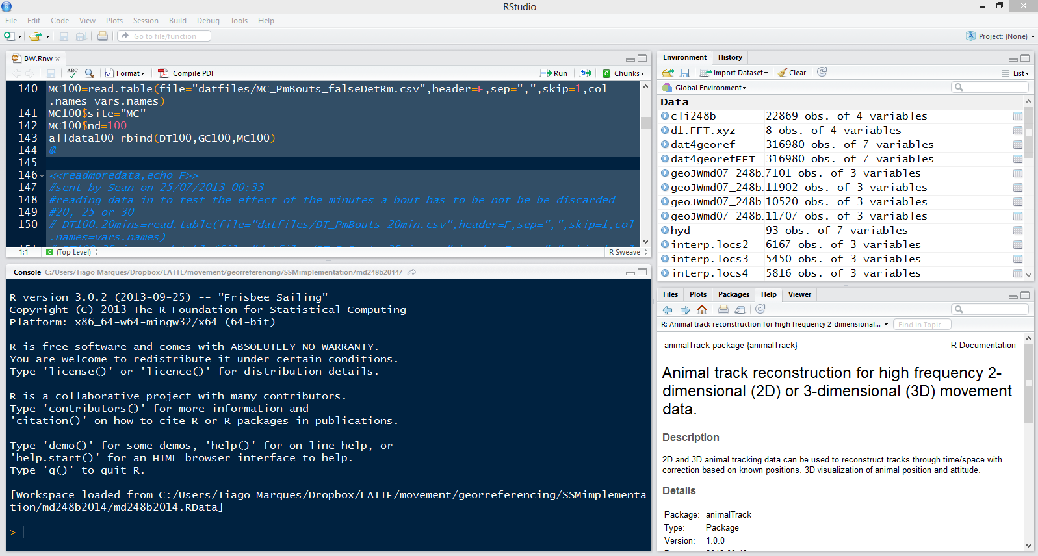
RStudio
(as R) Free and open source
An integrated development environment for data analysis
Simplifies the user interaction with R
In a single application you have access to a number of windows containing the code, the command line, the figures, the help, a windows explorer, etc.

Slide 8
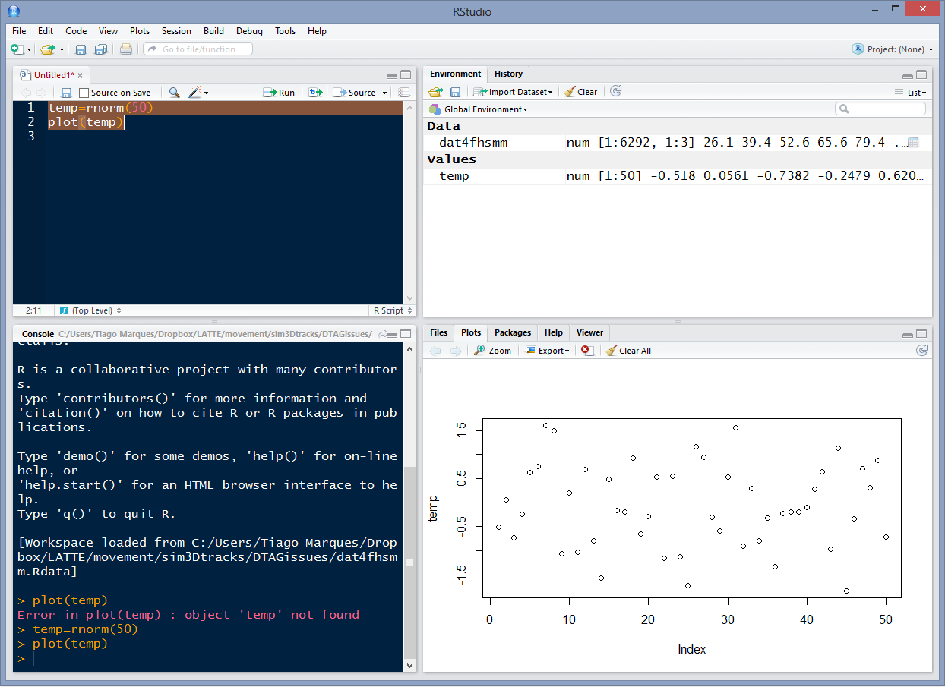
4 windows, 4 ways to interact with R
code
workspace
command line
plots

Slide 9
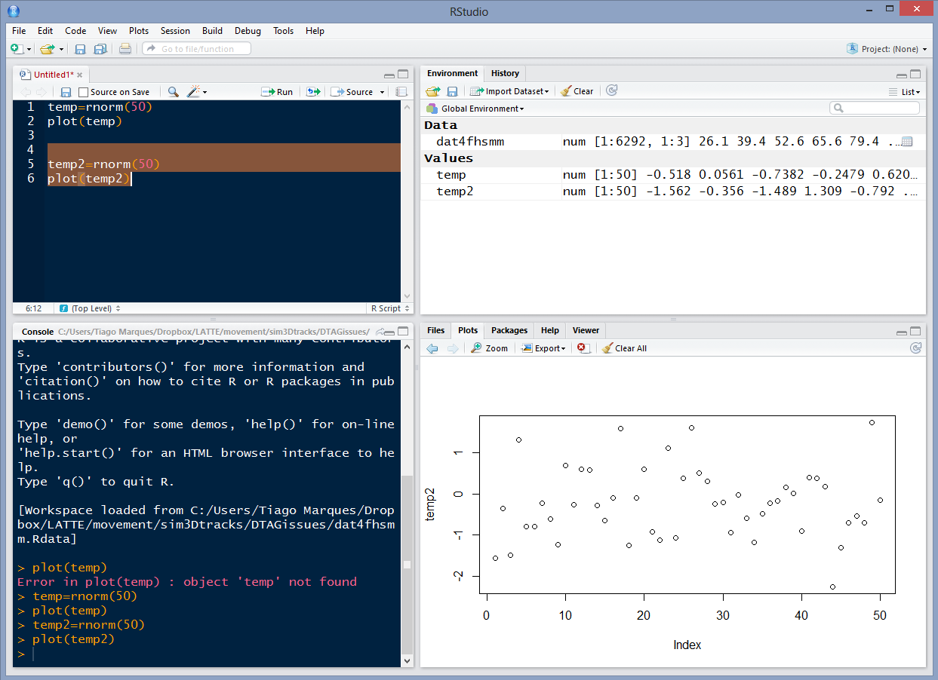
The code and plots tabs
Sends and executes current line or selected text to console
Move back and forth in a figure log
Export figures as pdf or jpeg

Slide 10
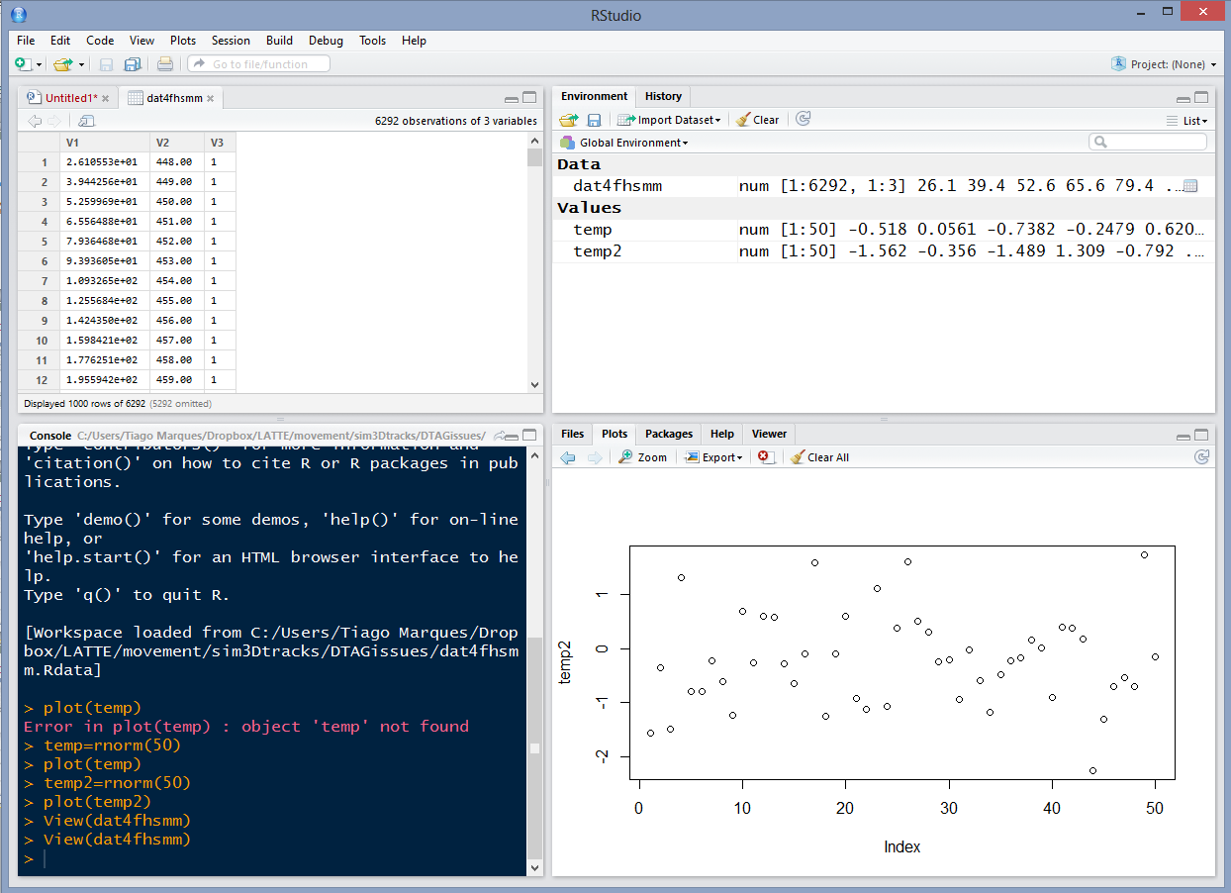
The environment tab
Shortcut for data import
Objects available in workspace (+ details)
Pressing most objects names gives you a preview of what they are

Slide 11
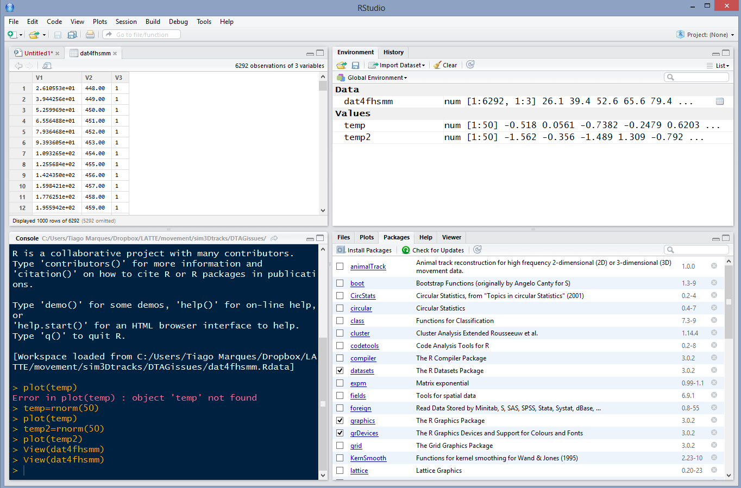
The packages tab
install a package
an installed package
an installed and loaded package
click the name for package description

Slide 12
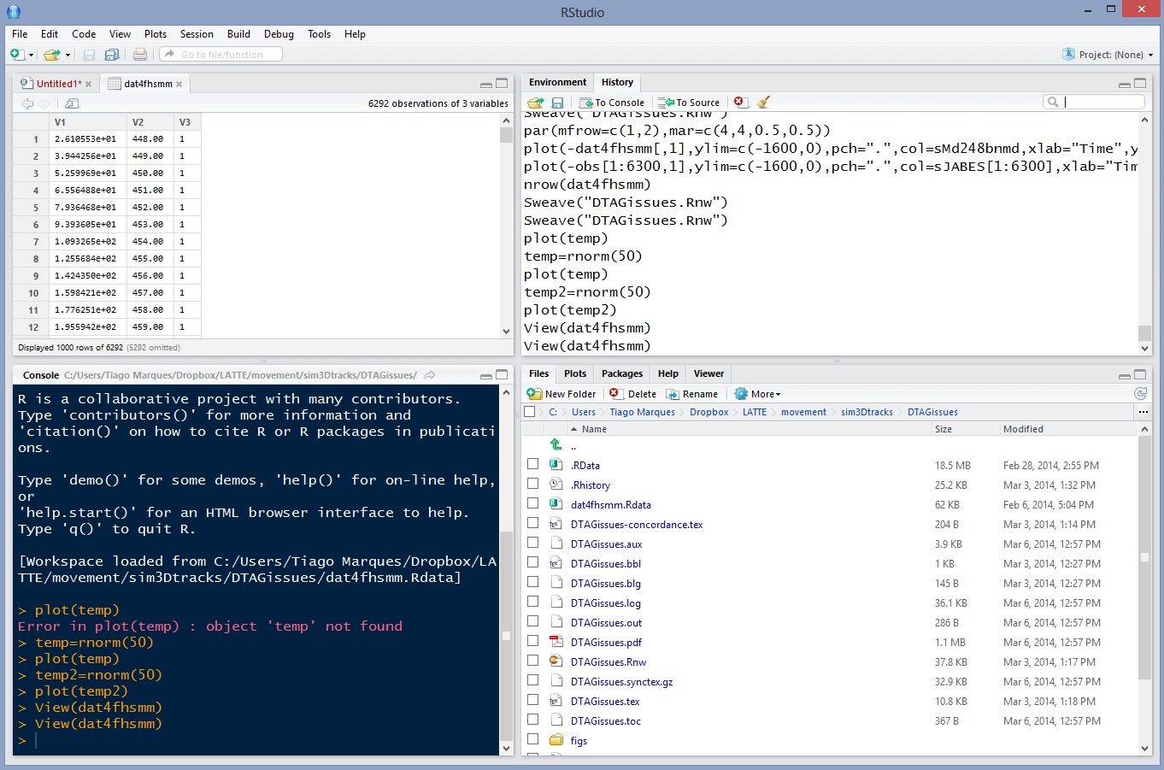
The history and “windows explorer” tabs
The command history (with shortcuts to send commands to source or console)
To see the files in your working directory
(select a file to load or open it)

Slide 13
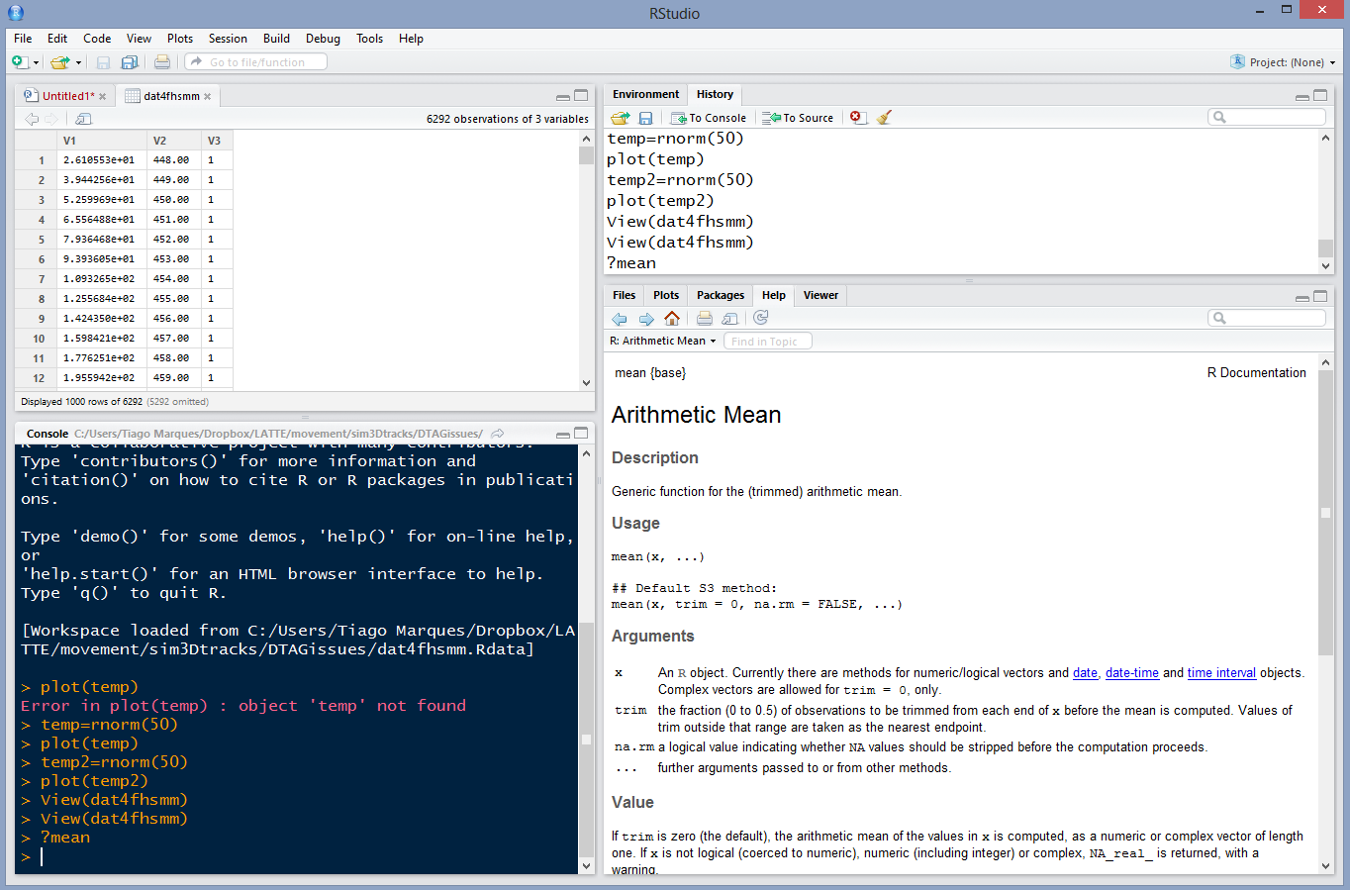
The help tab
If you call for help...
This is where it will show up
With hyperlinks for easy navigation

Slide 14
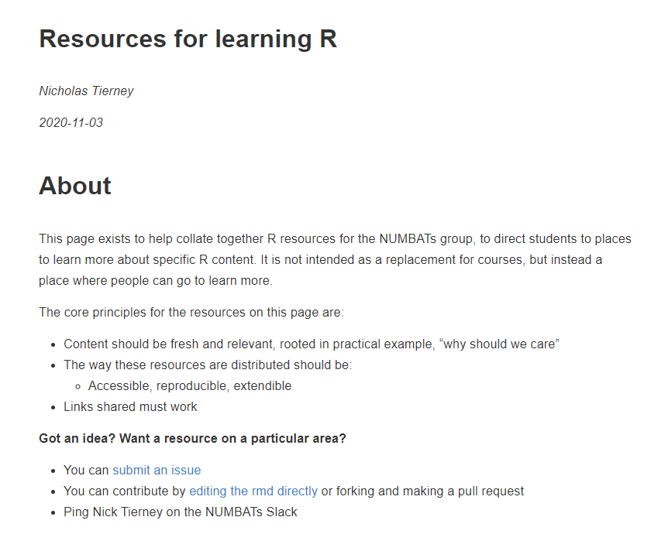
R HAS AMAZING (ENDLESS) ONLINE RESOURCES
https://resources.numbat.space/index.html
Just an example!
Check also the landing page at https://github.com/TiagoAMarques/AnIntro2RTutorial

Slide 15
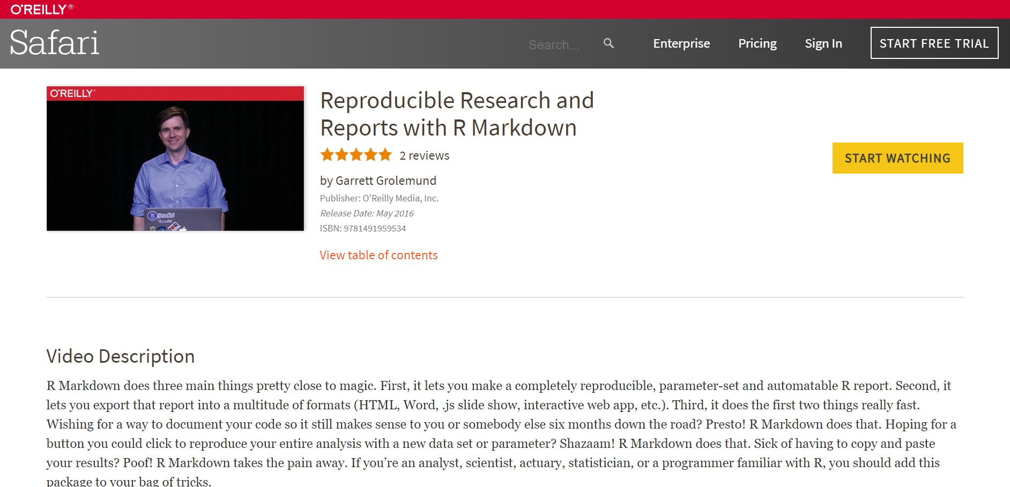
R Markdown and Dynamic Reports
https://www.oreilly.com/library/view/reproducible-research-and/9781491959534/video245667.html

Slide 16
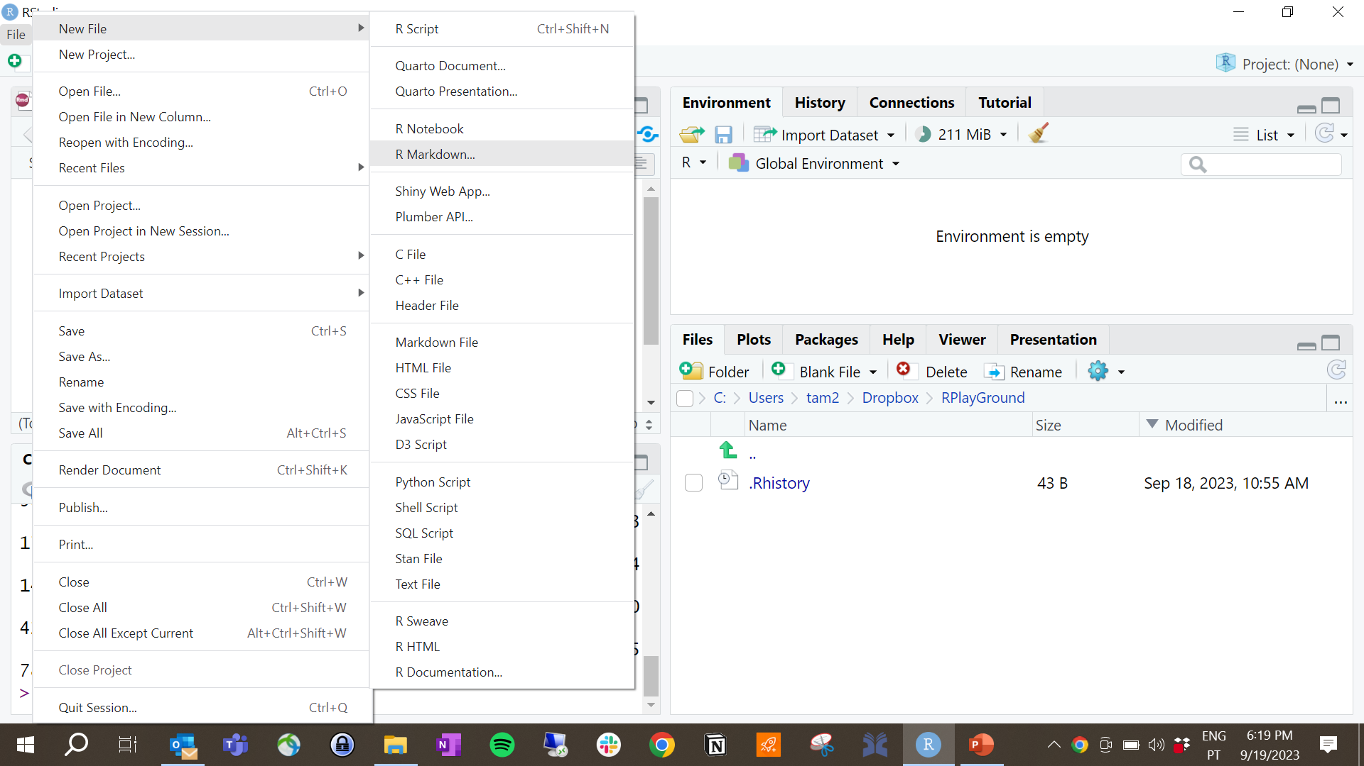
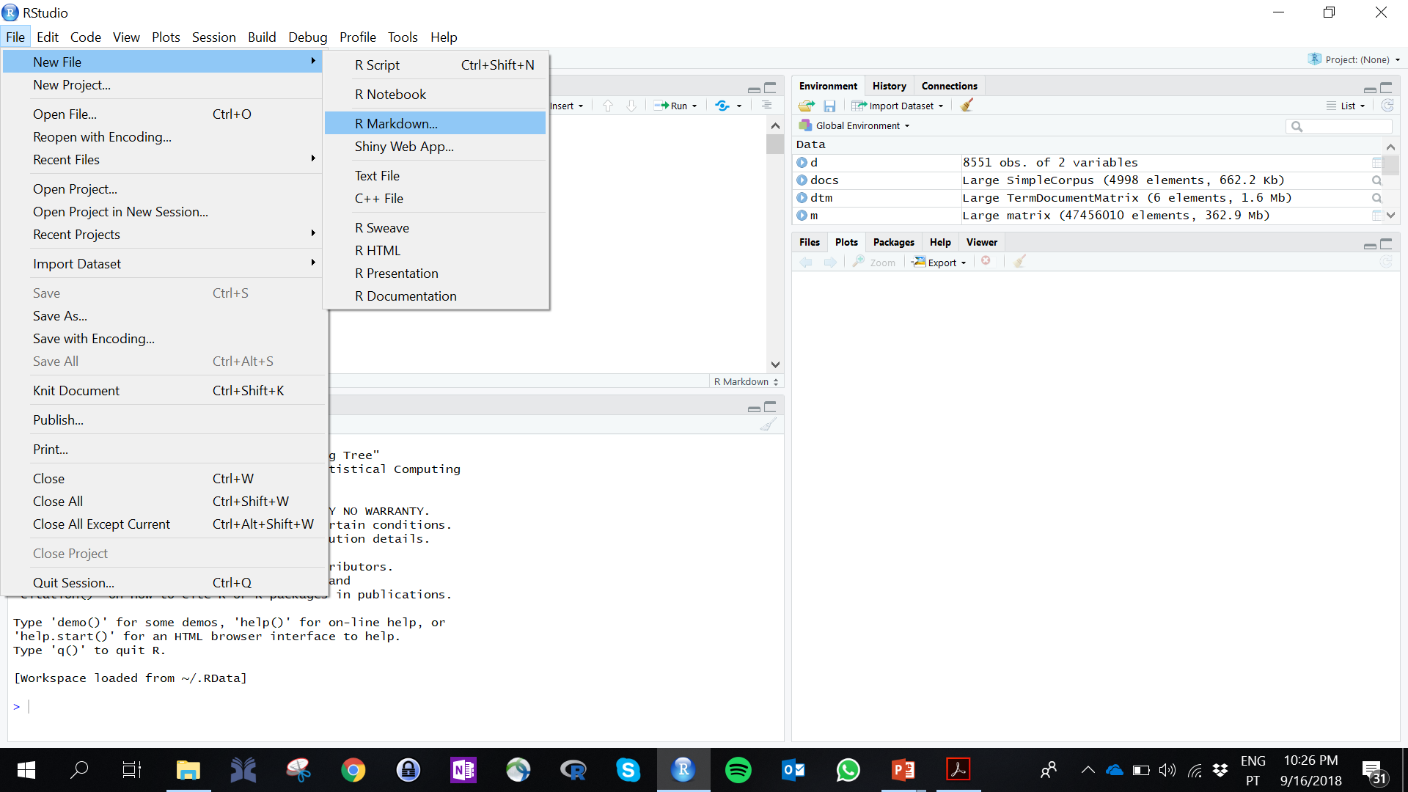
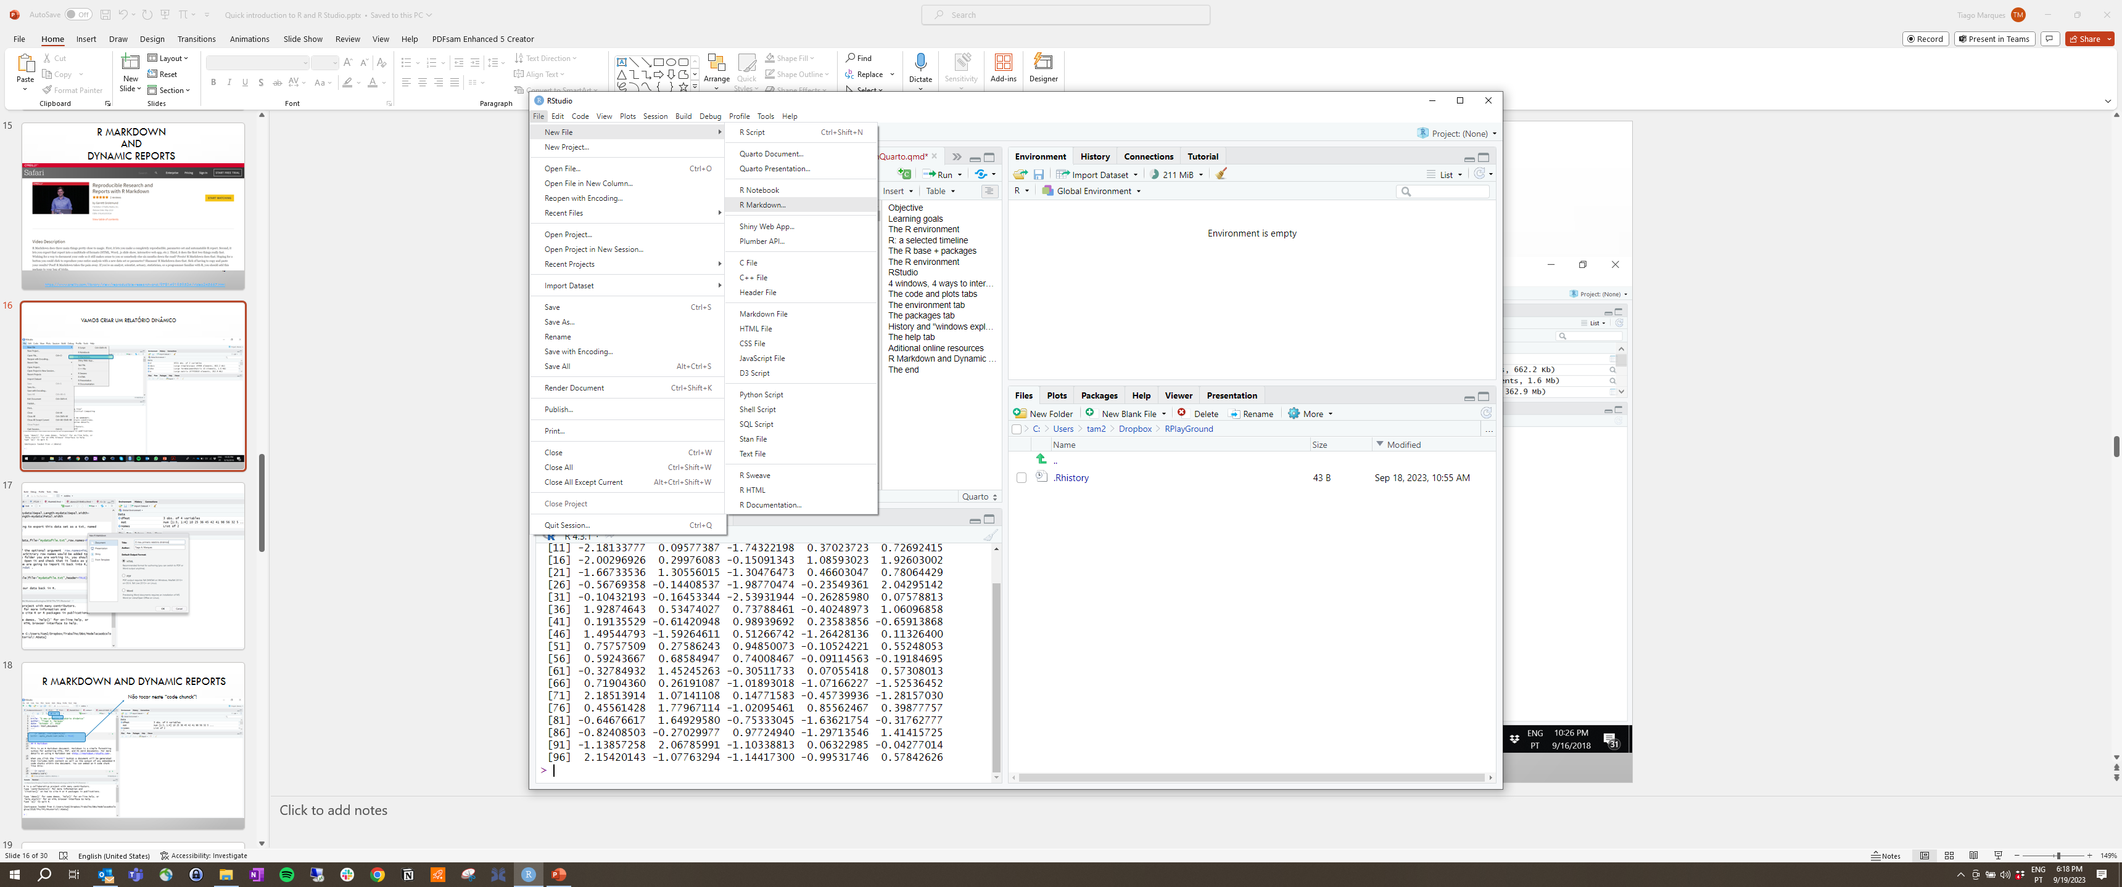
VAMOS CRIAR UM RELATÓRIO DINÂMICO

Slide 17
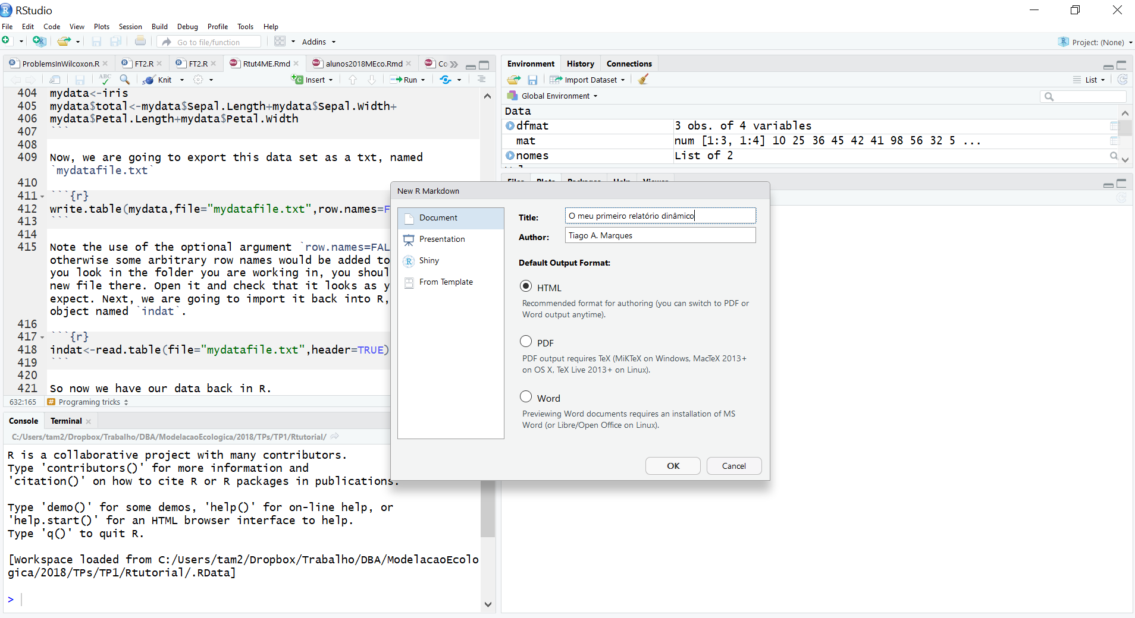

Slide 18
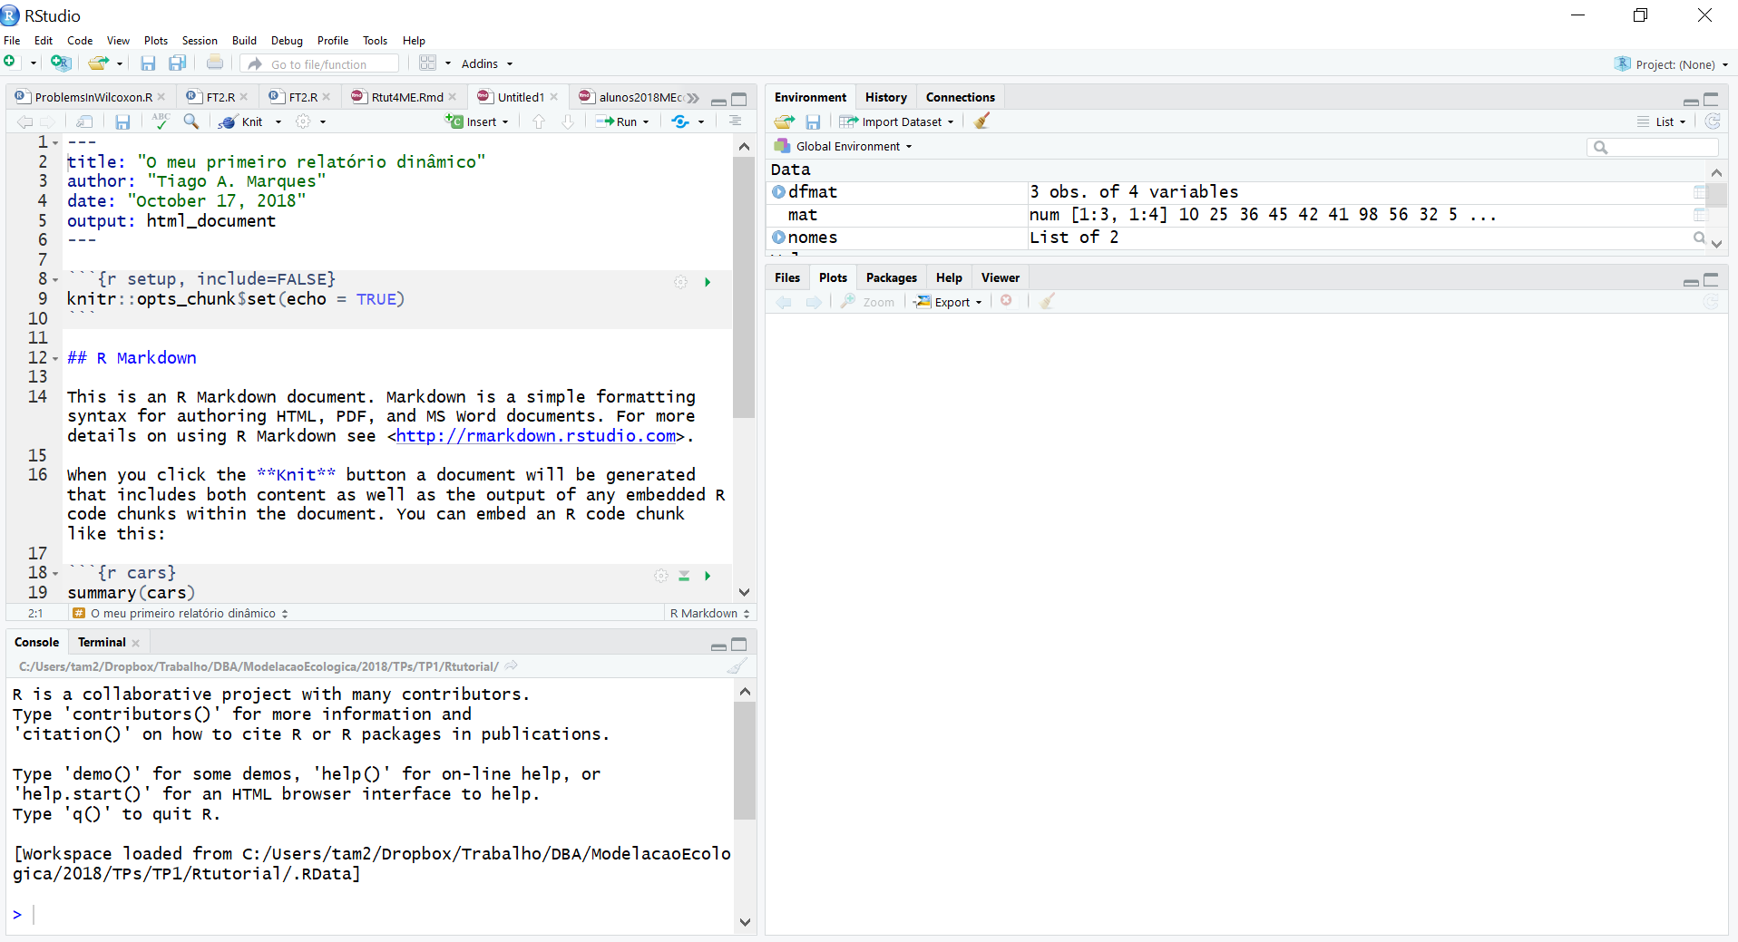
R Markdown and Dynamic Reports
Não tocar neste “code chunck”!

Slide 19
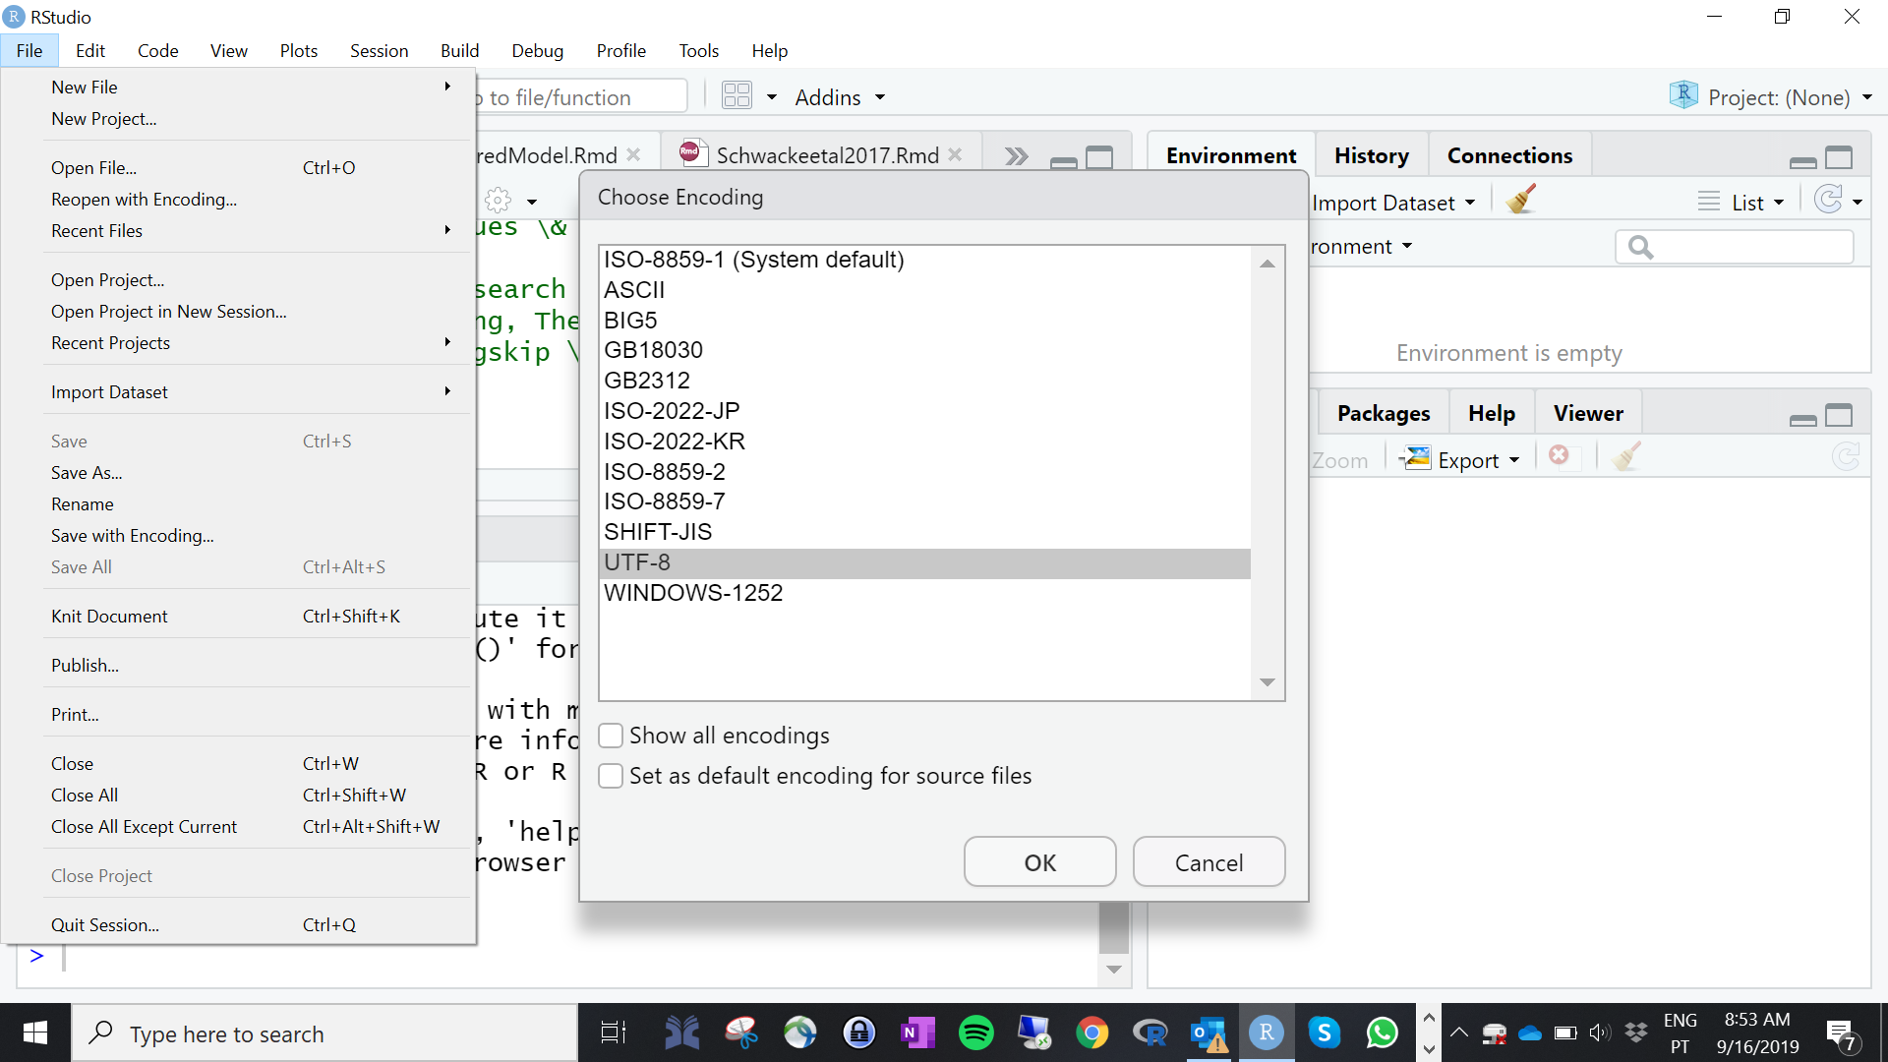
Caracteres portugueses (acentos, cedilhas, etc) desformatados?
Para poderem usar caracteres portugueses (tipo ~,ç,õ)
x
19

Slide 20
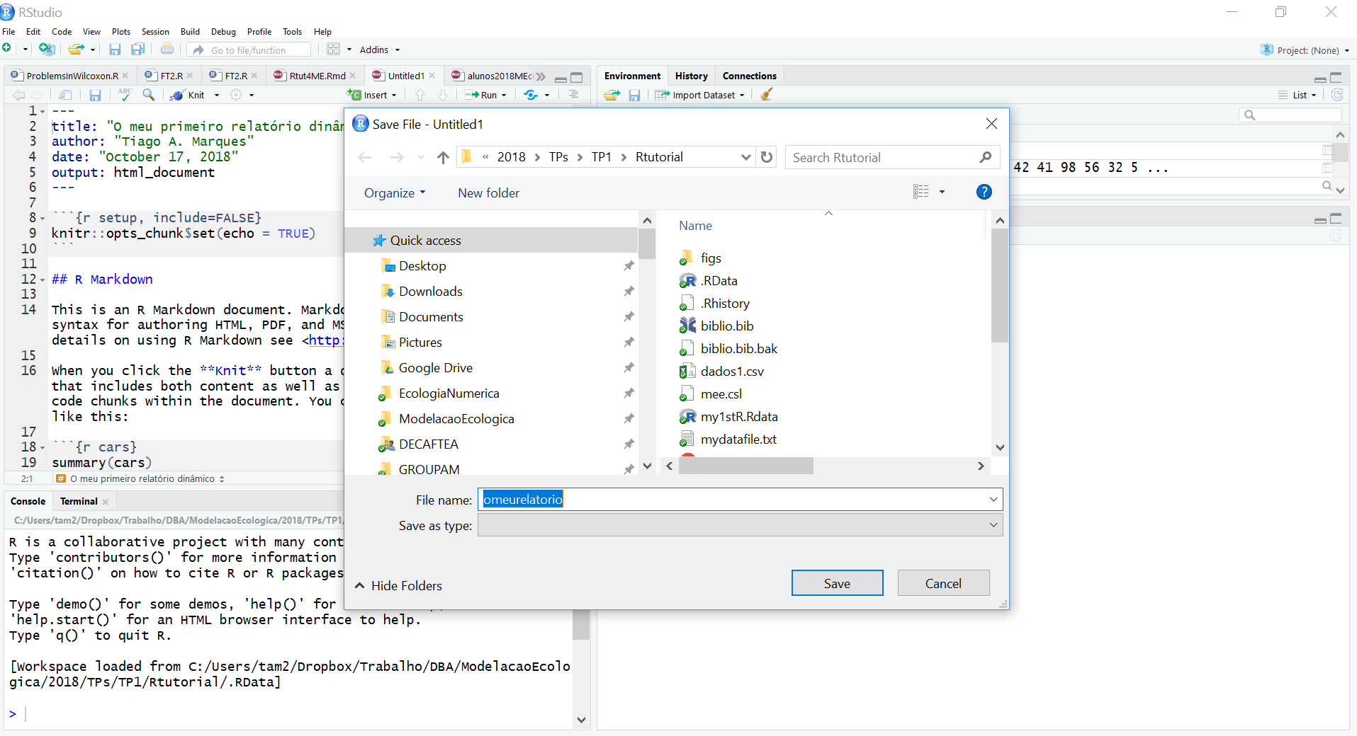
Definir o nome e onde querem guardar o vosso relatório

Slide 21
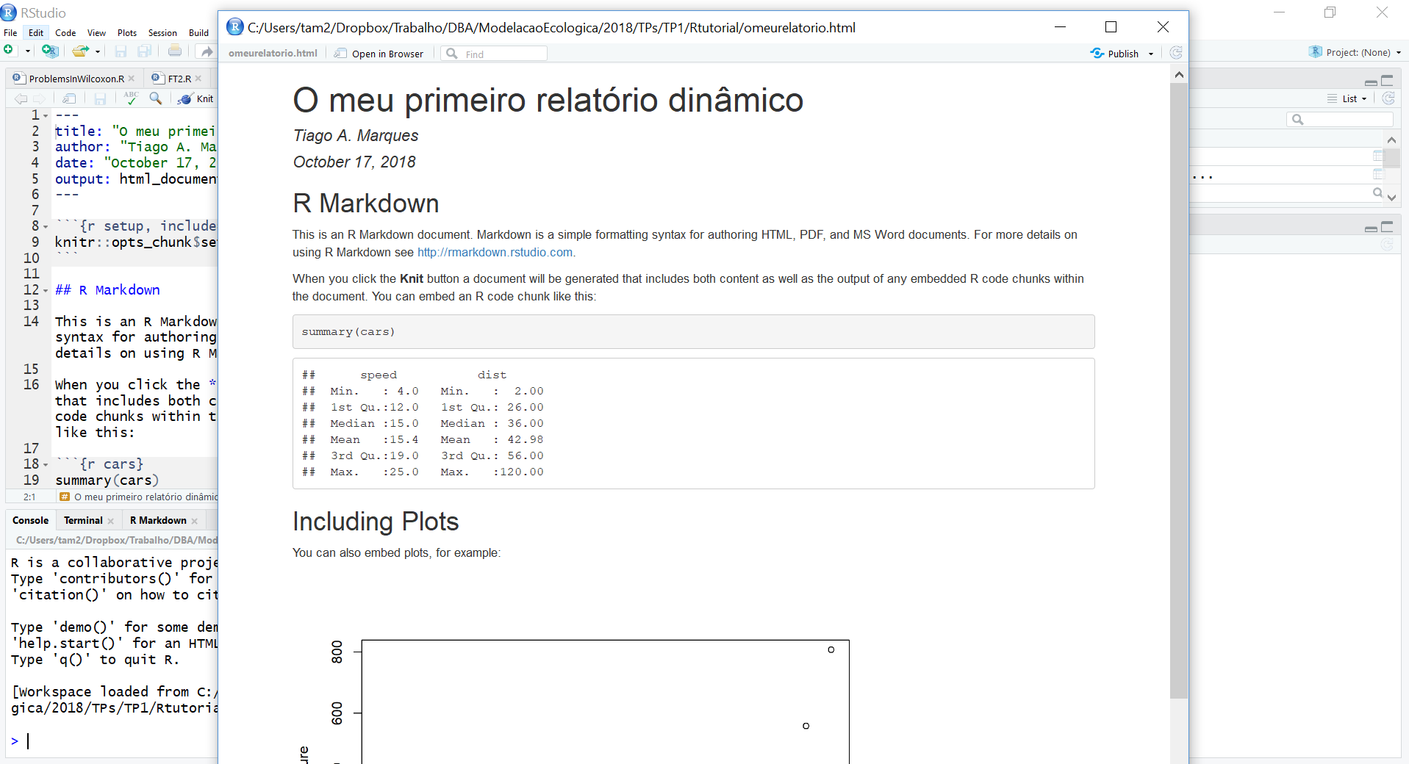
E cá está ele! O vosso primeiro HTML criado automaticamente ao compilarem o ficheiro omeurelatorio.Rmd. Na realidade, é possivel criar outputs em pdf e word (mas o pdf implica software adicional – latex - e o word às vezes não corre bem – usar por vossa conta e risco!)

Slide 22
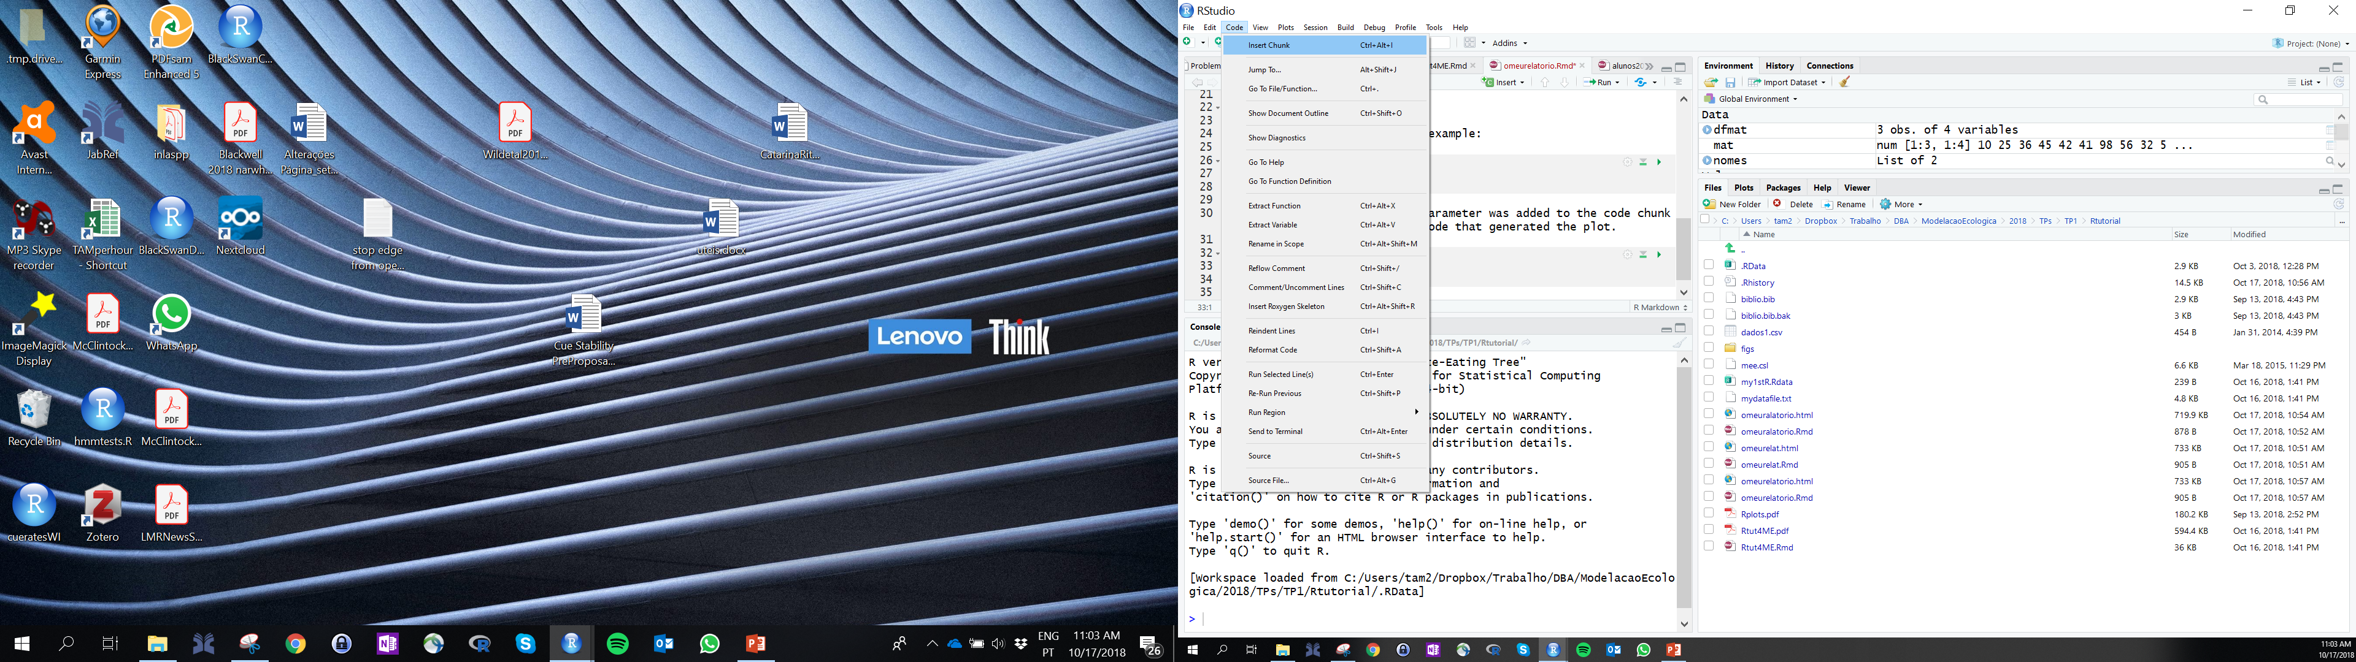
Como inserir um novo “code chunck”

Slide 23
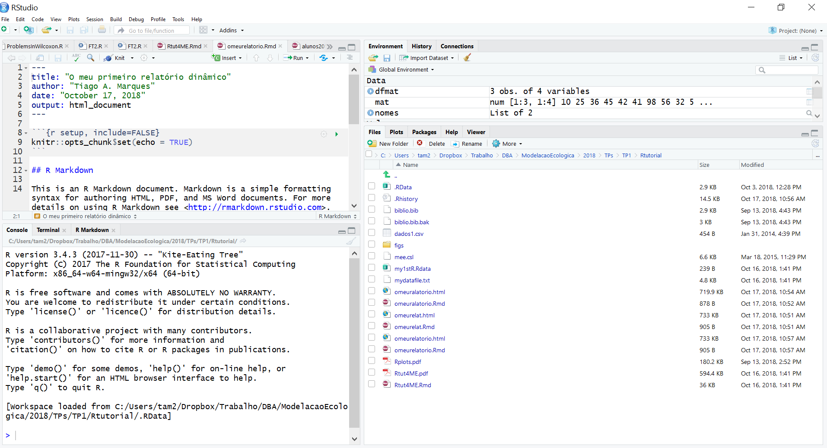
IMPORTANTE
O que é executado na linha de comandos é independente do que está no relatório dinâmico (no .Rmd).

Slide 24
Tips and tricks
É muito mais Seguro compilar todo o documento do que corRer code chuncks em separado
Um .RMD não é um script usual, tem cÓdigo e texto. O resultado é um documento dinâmico, com Texto, Código, e OUTPUTS do código
O código está sempre, sempre, sempre dentro de um code chuck!
Os comentários ao Código também estão dentro dos code chunks (precedidos de “#” – o simbolo de cardinal). EXEMPLO:
# isto seria um comentário - se coRrer as
# próximas linhas de Código o resultado é 11
A<-3
B<-8
A+B

Slide 25
Useful RMARKDOWN WEB Resources
https://github.com/TiagoAMarques/RMarkdownTemplate (A template made just for you!)
https://rmarkdown.rstudio.com/
https://bookdown.org/yihui/rmarkdown/ (fRee online book)
https://r4ds.had.co.nz/r-markdown.html (fRee online book: R FOR DATA SCIENCE)
https://bookdown.org/ - how to write a book with markdown, with several VERY USEFUL BOOK examples
BE PROACTIVE: EXPLORE RESOURCES!

Slide 26
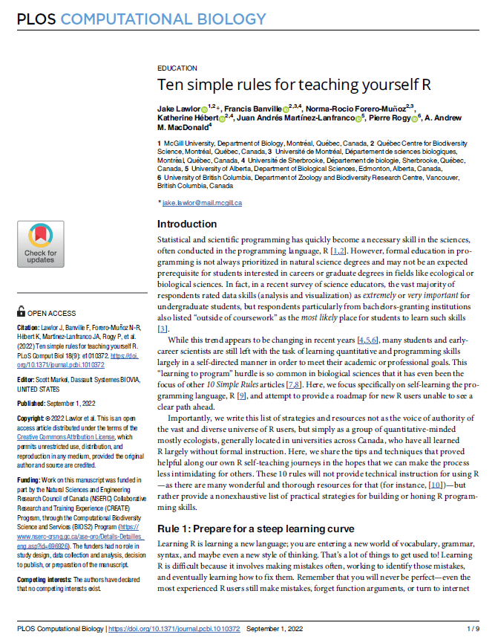
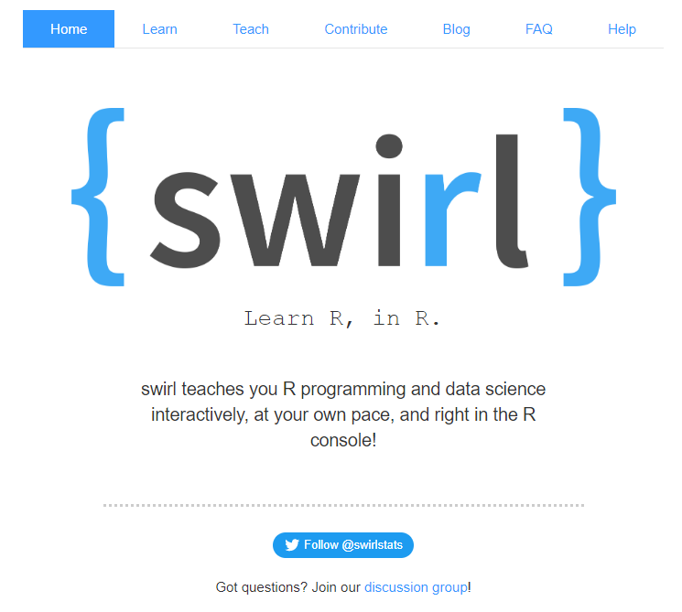
Teach yourself
https://swirlstats.com/
Link 2 Paper

Slide 27
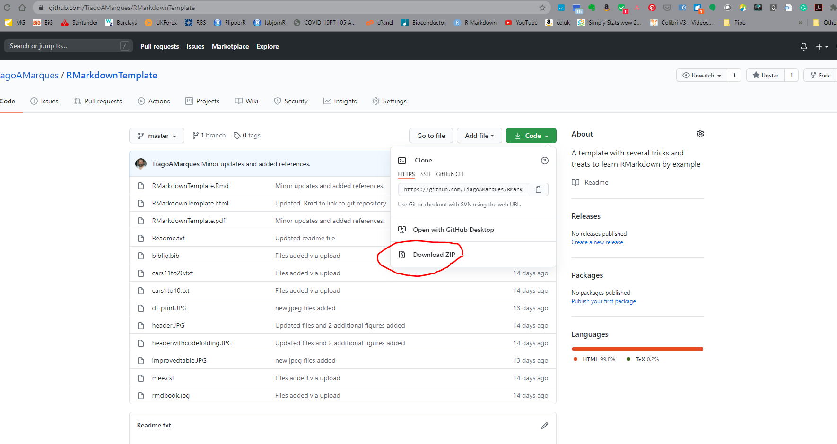
AN RMARKDOWN TEMPLATE
How to download the template
https://github.com/TiagoAMarques/RMarkdownTemplate

Slide 28
An example of why reproducible research is great
Open ExampleDataAnalysis.Rmd
Compile it and see the results
Implement the last few actions
Recompile the report
Compare the results obtained

Slide 29
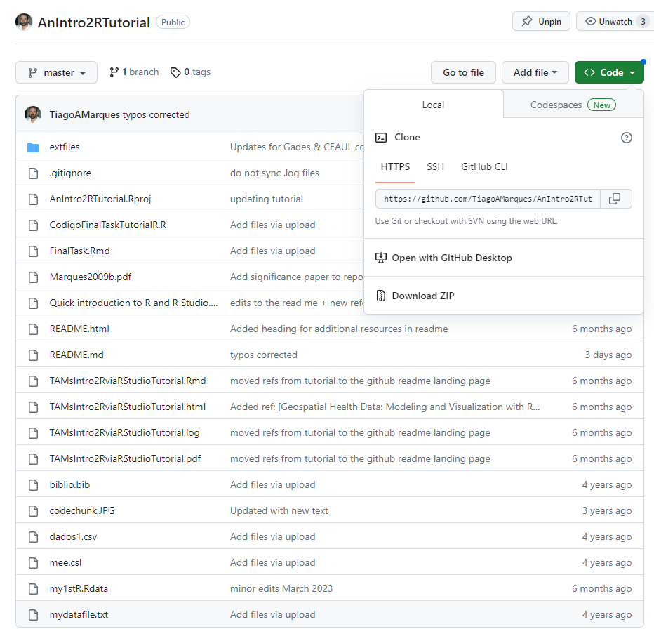
https://github.com/TiagoAMarques/AnIntro2RTutorial
Download, unzip and use

Slide 30
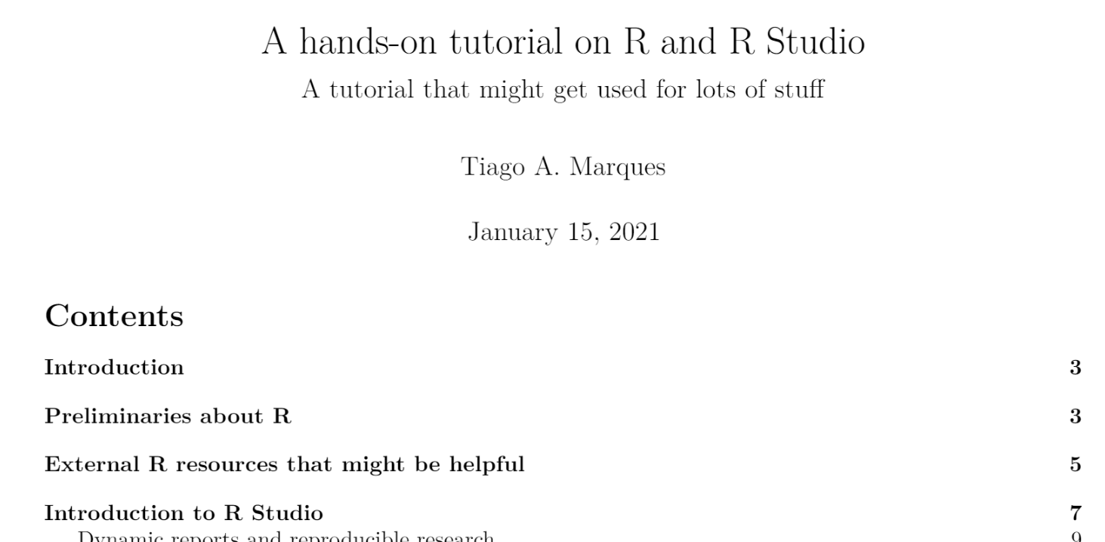
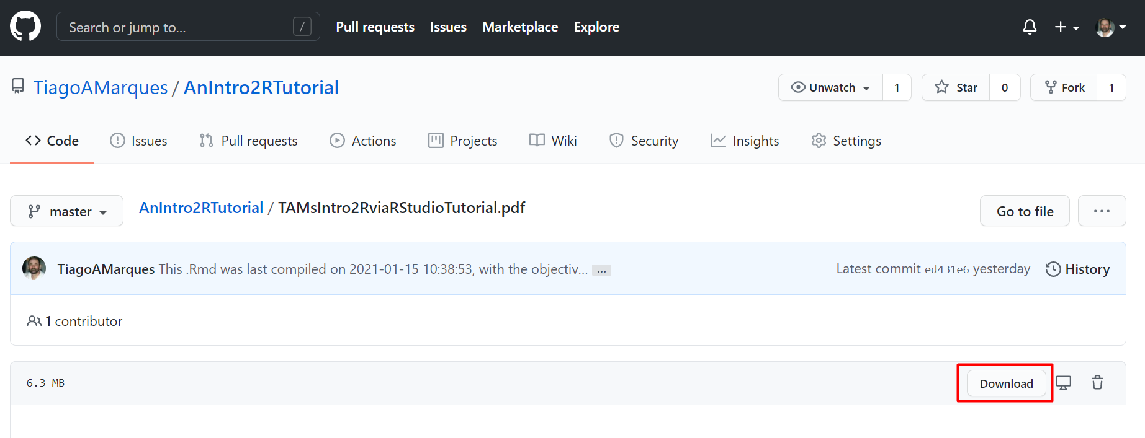
Now... open the hands on tutorial
https://github.com/TiagoAMarques/AnIntro2RTutorial/blob/master/TAMsIntro2RviaRStudioTutorial.pdf

